Slide 1
Provider Level Reporting
Presented By:
Lucía Lapaz, Brittany Ersery & Jim Holsinger
Envision Technology Partners, Inc.
September 2019

Slide 2
Agenda
Patient Management Reports
Coverage Statistics Reports
Data Quality Reports
CoCASA

Slide 3
Patient Management Reports

Slide 4
Birth Vaccinations
Generates a list of patients who have (or have not) received a birth dose of the selected vaccine(s)
Timeliness is reported if patient birth time and vaccine administration time have been recorded

Slide 5
Inactivate Patients
Includes all Active patients at the selected Clinic
Patients can be changed to one of the following Inactive status codes:
Lost to Follow Up
No Longer a Patient

Slide 6
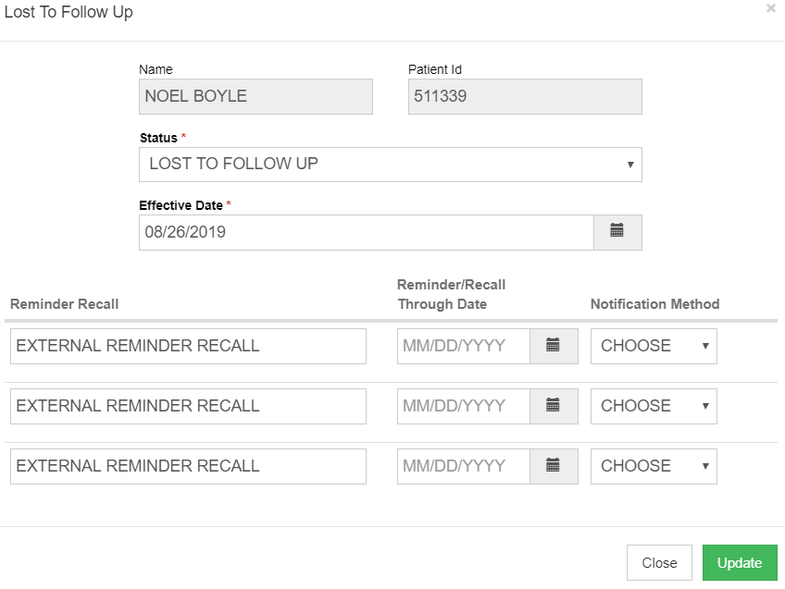
Inactivate Patients (cont.)
Patients who qualify for ‘Lost to Follow-Up’ are noted with a green checkmark icon
Lost to Follow-Up Requirements:
At least 3 reminder/recall attempts
AND no vaccinations within the last 120 days
Notes:
Notification Method controlled by new code table ‘Reminder/Recall Notification Method Codes’.

Slide 7
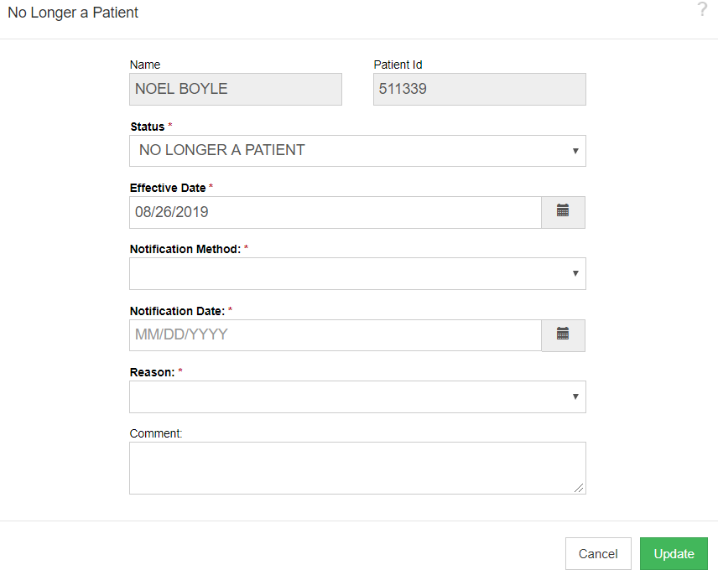
Inactivate Patients (cont.)
Patients can be manually updated to Inactive - No Longer A Patient
If Reason OTHER is selected, Comment is required

Slide 8
Patient Detail with Services
Generates a list of patient immunization history by provider/clinic, including:
Patient Details
Full Name, Patient ID, DOB, VFC Eligibility (patient-level)
Patient Default Clinic
Vaccination Details
Date Given, Administering Clinic, Vaccine, Lot Number, Funding Source, Immunization-level eligibility
Indicates if vaccine is historical and/or invalid
User who created and last updated the record
Excel and extract versions contain additional data:
Other ID (Party ID)
Gender

Slide 9
Patient List by Insurance Source
Generate a list of patients grouped by insurance source, including patients with no insurance
All patient insurance sources are included (rather than only the primary insurance source)
Patient insurance sources are recorded on the Demographics screen

Slide 10
Patient List / Counts by Clinic
Summary Report
Count of patients by Clinic
Patient counts are subtotaled by age group within each Clinic
Detail Report
Includes information provided in summary version
Also includes patient roster per clinic, including:
Patient ID
Full Name
DOB
Notes:
Note: Guam has their own version of this report.

Slide 11
Patient Reminder / Recall
Generate a list of patients due and/or overdue for vaccinations
Choose from a variety of search criteria to target patients included in the reminder/recall
Reminder/recall runs are processed nightly
Three versions:
Provider/Clinic
County/ZIP Code
School District/School

Slide 12
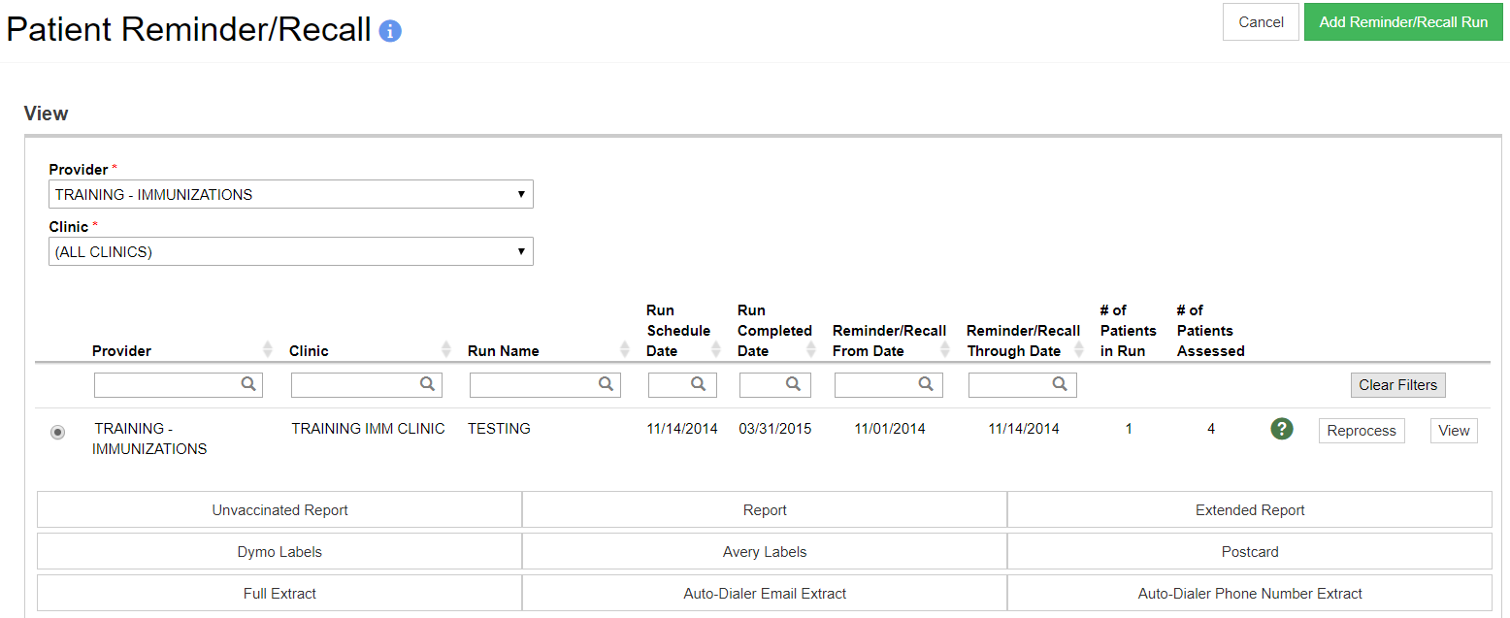
Patient Reminder / Recall (cont.)
1
3
2
Add a new Reminder/Recall run.
View existing Reminder/Recall criteria.
Reprocess a Reminder/Recall after records of patients included in initial run have been changed.

Slide 13
Reminder / Recall Output
Unvaccinated Report: Lists patients meeting Reminder/Recall criteria that have not returned for immunizations since the reminder/recall was run.
Report: Lists all patients meeting Reminder/Recall criteria.
Dymo Labels: Generates a set of address labels designed to be printed on a Dymo Label printer.

Slide 14
Reminder / Recall Output (cont.)
Avery Labels: Generates a set of address labels designed to be printed on Avery 5160 style labels.
Postcard: Generates a report suitable to print pre-formatted reminder postcards.
Full Extract: Generates a CSV file containing patient data for patients included in the Reminder/Recall.

Slide 15
Reminder / Recall Output (cont.)
Auto-Dialer Email Extract: Generates a CSV file containing Patient Email Address, Patient ID, and Patient Name for patients included in the Reminder/Recall.
Auto-Dialer Phone Number Extract: Generates a CSV file containing Patient Phone Number, Patient ID, and Patient Name for patients included in the Reminder/Recall.

Slide 16
Patient Roster
Generates a list of patients belonging to a provider/clinic(s)
Patients are sorted by status, then name
Group results by default clinic or by patient county of residence

Slide 17
Patient VFC Eligibility History
Users can run report by individual patient or by Provider/Clinic
Generates a historical view of a patient’s eligibility, including the date and time of every change
Report output includes:
Patient ID, Name, DOB, VFC Eligibility
Vaccine, Vaccination Date, Eligibility at Vaccination, Funding Source
Last Updated Date and Time

Slide 18
Patients First Seen
Generates a list of patients who received their first vaccination from the selected clinic(s) during the specified date range
Report output includes:
Patient ID, Name, and DOB
Date first seen
Date last seen
Patient status

Slide 19
Patients with Active Exemptions
Generates a list of patients with one or more vaccine exemptions
Two report types:
Statistical Summary
Patient View
Output includes:
Number of patients by each exempted vaccine
Percentage of exempted patients
Available as PDF or extract

Slide 20
Patients with Adverse Reactions
Generates a list adverse reactions reported for a vaccination
Report output includes:
Patient Name, ID, DOB, Gender
Vaccine, Vaccination Date, Reaction Date, Date Reported to VAERS, Reaction, Severity, Consequence
Patient Default Clinic, Administering Clinic, Reporting Clinic

Slide 21
Patients with Notes
Generates a list of patient with one or more notes
Two versions:
Provider/Clinic
School District/School
Output includes:
Patient ID, Name, DOB, Gender, Note Text, Note Type, Note Date, Note Author
Available as PDF or extract

Slide 22
Patients with Vaccine Refusals
Generates a list of patients who have refused one or more vaccines
Three versions:
Provider/Clinic
County/ZIP Code
Datamart
Output includes:
Number of patients by vaccine refused
Number of patients by refusal reason
Available as PDF or extract
Notes:
Note: A user will only see counties/zip codes belonging to the address of the provider/clinics to which they are associated. Users can only select county OR zip code to run this report, but not both.

Slide 23
School Enrollments with Patient Exemptions
Lists patients with exemptions linked to school enrollments
Input Criteria includes:
School District / School
Grade Range
Enrollment Date Range
Option to include Inactive (or expired) exemptions
Output is Excel

Slide 24
Vaccine Recall
Search for patients who received a dose from a lot number that has been recalled
Option to search for one or more lot numbers
Report will search for all exact matches to the values entered in the Lot Number field
Available as PDF or extract

Slide 25
Patient with Precautions/Contraindications
Generates a list of patients with the selected allergy/risk(s) by Provider/Clinic
Two versions:
Provider/Clinic
School District/School
Output Includes:
Patient information, allergy/risk(s), and associated vaccines
Available as PDF or extract

Slide 26
Patient Management Reports
Hands-On Exercise

Slide 27
Coverage Statistics Reports

Slide 28
Clinic Immunization Count
Lists the number of vaccinations by vaccine type and provider/clinic during a specified date range
Totals by clinic include:
Number of vaccinations administered
Number of patients receiving one or more doses
Historical vaccinations are not included in results

Slide 29
Coverage Assessment Snapshot Reports
Includes AFIX and IQIP assessment templates
IIS administrators can create custom templates via the system code tables to perform additional assessments

Slide 30
System-Reserved Templates
AFIX Adolescent (Official and On-Demand)
AFIX Childhood (Official and On-Demand)
IQIP Adolescent (Official and On-Demand)
IQIP Childhood (Official and On-Demand)
Master Rate Comparison
Master Rate Comparison Adolescent
Master Rate Comparison Childhood

Slide 31
AFIX/IQIP Childhood & Adolescent Assessments
MANAGE AFIX ASSESSMENTS user security function required to create and/or delete assessments
Results retained for 3 years
Available in the following output types:
Excel
PDF
XML (for upload into PAPA)

Slide 32
On-Demand Childhood & Adolescent Assessments
Any user with ADD privileges to the Reports module and access to ‘Coverage Statistics’ reports category can create an on-demand assessment
Results retained for 30 days
Available in the following output types:
Excel
PDF

Slide 33
Single Antigen Assessment
Provides additional details on the patient cohort defined for an assessment
Denominator = Entire assessment cohort
Numerator = All patients that have achieved the specified number of age-appropriate valid doses for the selected number of doses in each vaccine series
This report is not looking for patients who are UTD, but rather only patients who received the exact number of specified doses at various age milestones and patients deemed immune

Slide 34
Not UTD / Missing Immunizations Patient Listing
Provides additional details on the patient cohort defined for an assessment
Report includes all patients who are not up-to-date or are missing immunizations, based on the vaccine(s), age, and date ranges set by the user, including:
Forecast status of ‘overdue’ or ‘coming due’
Patients who have not received the appropriate number of doses
Patients with non-medical exemptions
Patients with no recorded vaccinations
Patients who have ‘aged out’ of the vaccine series and did not receive the appropriate number of doses before the max age
Patients with precaution/contraindications

Slide 35
Missed Opportunities Patient Listing
Provides details on the patients who were considered Not UTD at their last immunization visit.
Report includes patients:
have not received the appropriate number of doses but were eligible to receive on date of last immunization visit
have not received the appropriate number of doses but were eligible to receive on date of last immunization visit and received an incorrect dose due to incorrect product used
have a religious or personal exemption noted for the specified vaccine

Slide 36
Invalid Dose Patient Listing
Patients included have one or more invalid vaccinations recorded on their immunization record, for the selected series/antigens.

Slide 37
Patient Roster
List of active patients that are included in the selected cohort or snapshot.

Slide 38
Master Rate Comparison Report
‘Ranking’ of provider/clinics by performance, or % of patients up-to-date
Can be used to identify and prioritize provider/clinics in need of AFIX/IQIP visits
Report is auto-generated twice per year on June 1st and December 1st
Users must have MANAGE AFIX ASSESSMENTS security function to view comparison data for All Providers/All Clinics

Slide 39
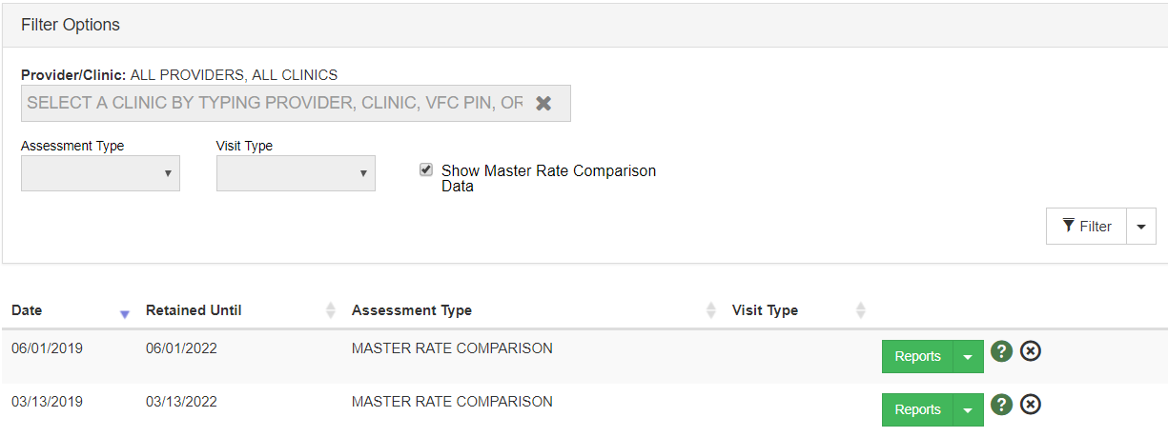
Master Rate Comparison (cont.)
Select ‘Show Master Rate Comparison Data’ – Provider/Clinic auto-selects ALL Providers/ALL Clinics
Click Filter
Click Reports

Slide 40
Master Rate Comparison (cont.)
Choose AFIX or IQIP

Slide 41
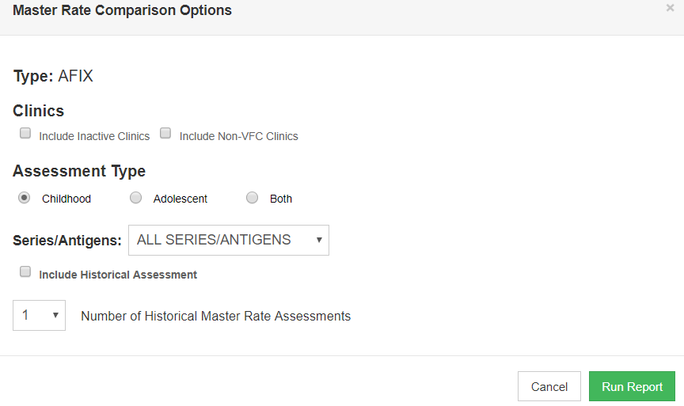
Master Rate Comparison (cont.)

Slide 42
Dosage Report
Counts of vaccines administered by dose number, vaccine, patient VFC eligibility and patient age at vaccination
Optional filters:
Vaccine
County
Funding source
Historical vaccinations are not included in results
Available as PDF, Excel workbook or extract

Slide 43
Doses Administered
Shows the usage of vaccines administered by funding source to help determine if vaccine ordering is appropriate
Provides patient or vaccination counts per funding source and/or vaccine group
Counts doses administered by the selected provider/clinic and not doses administered by the patient's default provider/clinic
Available as PDF or extract
Datamart version

Slide 44
Immunization Rates
Calculates percent of patients up-to-date on recommended immunizations
View coverage rates by antigen(s) or by vaccine series
Results are based on the Recommender, thus, invalid doses are not counted
Identify patients not up-to-date
Versions:
Provider/Clinic (also available in Datamart version)
County/ZIP Code
School District/School
Notes:
Note: A user will only see counties/zip codes belonging to the addresses of the provider/clinics to which they are associated. Users can only select county OR zip code.

Slide 45
Invalid Doses
Lists patients with invalid dose(s) based on:
Recommender
Invalidation by user on Edit Immunization screen
View invalid doses by antigen(s) or by vaccine series
Available as PDF or extract

Slide 46
Mass Events
Provides details of vaccinations administered and patients included in a Mass Event
Report Types:
Mass Event by Clinic
Mass Event with Funding and Vaccine Codes
Available in Excel only

Slide 47
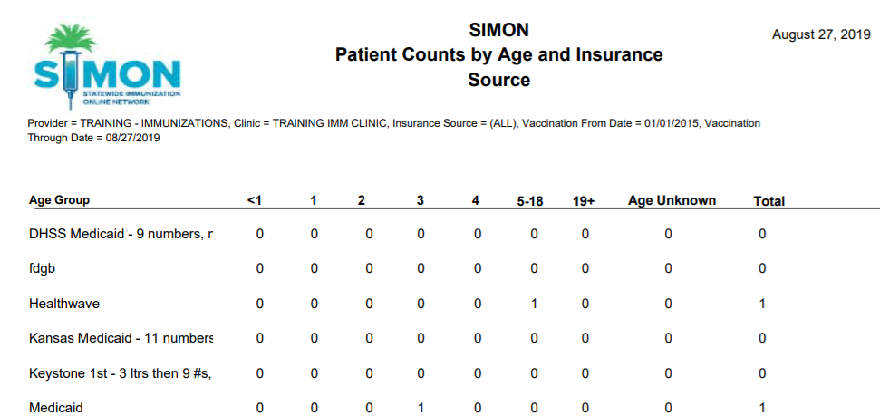
Patient Counts by Age and Insurance Source
Number of patients vaccinated during the specified date range per insurance source and age group.

Slide 48
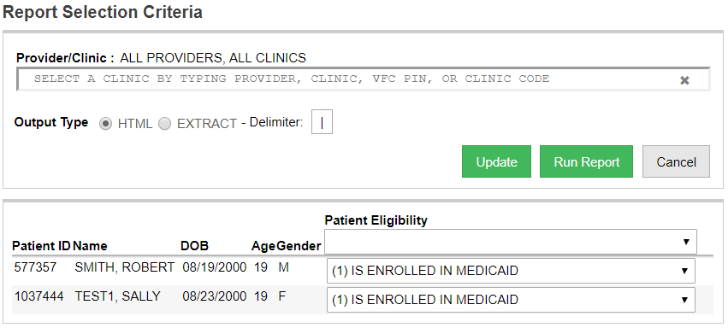
Patients Aged Out of their VFC Eligibility Code
Select the correct patient VFC eligibility.
Click Update.
2
1

Slide 49
Vaccinations by Funding Source
View number of doses administered by vaccine, dose number in series, and patient age group
Optional filters:
Vaccine funding source
Patient age range

Slide 50
Vaccine Borrowing Report
Generates a list of vaccines administered to patients with appropriate and/or inappropriate funding sources per patient VFC eligibilities
Correct mappings are maintained by administrators in the application code tables
If a mapping does not exist on the code table, it is considered “inappropriate”
Use this report to find "borrowed" vaccines or inappropriately vaccinated patients

Slide 51
VFC Category Patient Count Report
Generates a list of patients who have received a vaccination by VFC Eligibility and age group
Available as PDF or extract

Slide 52
Coverage Statistics Reports
Hands-On Exercise

Slide 53
Data Quality Reports

Slide 54
Data Quality - Statistics
Provides real-time statistics regarding:
Patient Counts
Patient Completeness
Vaccination Completeness
Accuracy
Timeliness
Must be restricted to a specific provider and clinic
Date range filters may not exceed 30 days

Slide 55
Data Quality - Patient Exceptions
Provides real-time statistics for a specific section of the scheduled report
Patient Completeness
Vaccination Completeness
Accuracy, Vaccination Given at Invalid Age
Accuracy, Vaccination Counts Inconsistent with Patient's Age
Option to filter results by a specific line item within a report section
Must be restricted to a specific provider and clinic
Date range filters may not exceed 30 days

Slide 56
Data Quality – Patient Immunization Exceptions
Provides real time statistics for patient cohort at a provider/clinic
Has Vaccinations Before Birth
Has Vaccinations After Death
Has Vaccinations With No Immunization Program
Has No Vaccinations With No Immunization Program
Has No Vaccinations With No Program
Has Death Record With Active Immunization Program
Has Death Record With Active Non-Immunization Program
Has Vaccinations With Inactive Immunization Program

Slide 57
Patients with Possible Duplicate Vaccinations
Generates a list of patients with multiple vaccinations of the same vaccine type within a specified number of days
Review the patient medical record and update the registry to reflect accurate immunization history
Datamart version available

Slide 58
Possible Patient Duplicates
Generates a list of possible duplicate patients in the registry
A nightly process checks the registry for patients with the same or similar name, DOB, and SSN
Users are able to identify possible duplicates via the Patients module
Resolve possible duplicate patients in the Administration module

Slide 59
Shots Before Birth
Generates a list of patients with vaccines administered before their date of birth
Resolve errors by correcting either:
Vaccination date
Patient date of birth

Slide 60
User Vaccination Details
Generates a list of patient vaccinations and the user(s) who created and last updated each record
Use results to review registry user productivity

Slide 61
Vaccines Added but not Administered
Generates a list of patients with vaccines added to their record, but not administered
Run this report before closing inventory reconciliations
Delete or administer vaccines as necessary

Slide 62
Data Quality Reports
Hands-On Exercise

Slide 63
CoCASA

Slide 64
Export Data for CoCASA
Generate a file to import into the CDC application CoCASA
Total number of patients included in the extract is displayed once processing is complete
Two versions:
Provider/Clinic
County/ZIP Code
Notes:
CoCASA (Comprehensive Clinic Assessment Software Application)

Slide 65
CoCASA
Hands-On Exercise

